Slide 1
Changing a Staffing Model for Low and Moderate Risk Suicidal Patients in an Emergency Department: A Quality Improvement Project
Amy MciNTosh
University of Detroit Mercy
Nur 7920: Doctoral Project presentation

Slide 2
Introduction
In 2017 1.5 million ED visits for suicide ideation or attempt. Covid has increased these numbers
10th leading cause of death in the USA
Few psych resources available. Local agencies incentivized by the State to keep patients out of inpatient settings
Michigan MHC has not been reformed since 1974
Suicidal patients wait in ED for disposition for long periods of time
Quality Improvement project took place in ED and designated space to move patients out of the hallway to a more appropriate and safe setting

Slide 3

Background
Psych patients wait on stretchers in the halls for hours to days with no treatment
Boarding of psych patients in an ED is associated with increased morbidity and mortality- consumes ED resources
Many patients have a dual diagnosis making placement more difficult
No supporting evidence to show that one on one observers is best practice

Slide 4
Significance
1500 hospital patient suicides in USA per year
  1/3 while under 1:1 observation or q 15 minute checks
Covid has increased demands for psych care in already strained healthcare systems
Social Determinants of Health updated in 2020 for Healthy People 2030 and includes its own category of SDoMH
Host facility averages 10 psych holds per day

Slide 5

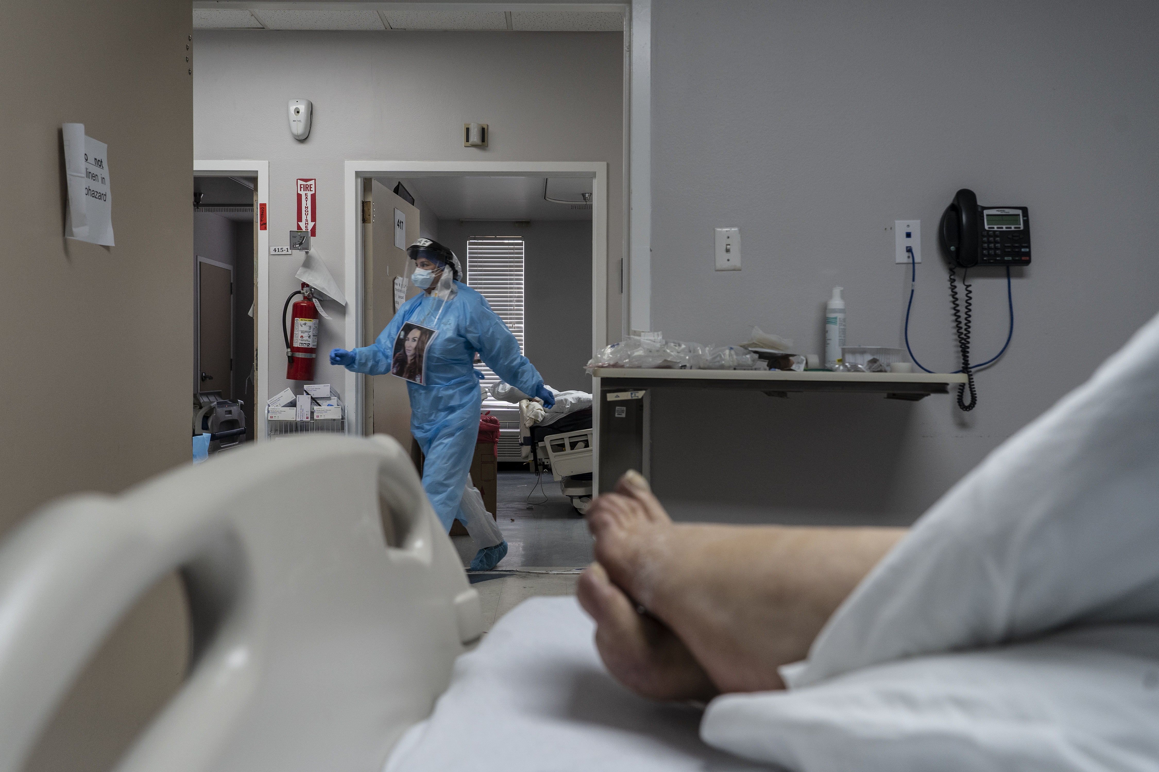
Clinical Question
Would a new staffing model for low and moderate risk suicidal patients increase staff engagement , keep patients and staff safe, and be fiscally responsible?

Slide 6
Literature Review
Three Major Themes
Suicide screening and risk assessments- patients must be screened with validated tools and risk management – low medium or high risk along with impulsivity. C-SSRS and Safe-T shown to be effective screening tools.
Safety and Management of suicidal patients in the emergency department – ability to keep these patients safe is difficult. Number of resources and cost. Lack of knowledge and comfort level of ED staff
The incidence of suicide or attempted suicide in the emergency department - Gaps in the literature for actual #of attempts or actual suicides in Eds. Environment huge concern: chaotic and lack of resources

Slide 7

Purpose Statement
The main goal or aim of this Quality Improvement Project is to evaluate a new staffing model for low and moderate suicide risk patients in the ED, utilizing trained mental health technicians to interact with patients and a camera monitor as compared to one –on- one observation.

Slide 8
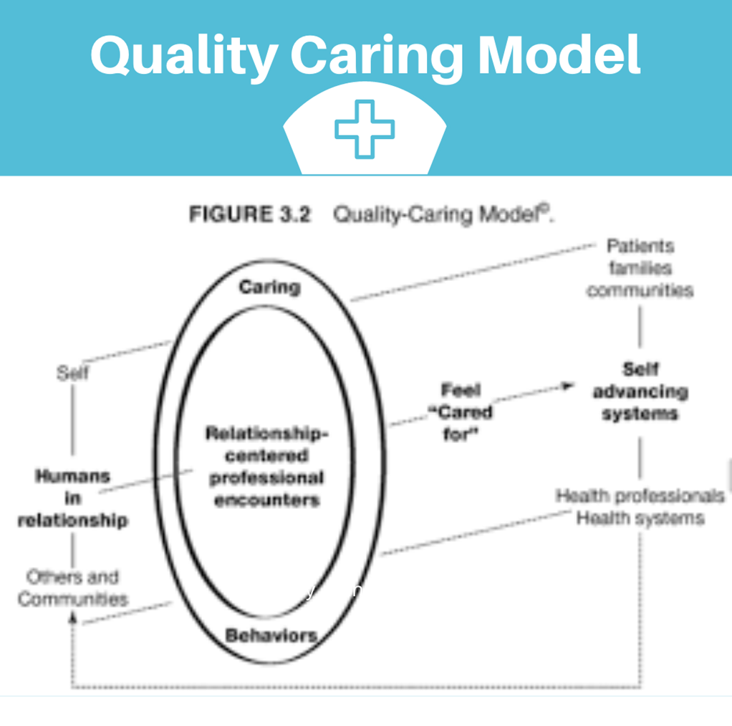
Theoretical Framework
Joanne Duffy Quality Caring Model first developed in 2003
Middle range theory has 4 main concepts: relationships with self, community, patients and families, and relationships with other health professionals
Relationship between nurse and patient has attributed to patient satisfaction, decreased symptom distress, authentic self-expression, sense of well-being and trust in nurses
Plan Do Study Act (PDSA) to support this QI project. Helpful to implement changes to become a permanent part of workflow

Slide 9
Methods/Design
Utilized questionnaires and observation for staff understanding and satisfaction with new model (pre and post implementation)
Data collection surrounding appropriate screening tool use
Data collection surrounding any near miss safety issues
Compare and contrast costs of traditional 1:1 model with new model
IRB obtained from host facility and UDM

Slide 13
Evaluation and Recommendation
Strengths: staff satisfaction with model. No safety concerns with new model- no suicide attempts
Location is ligature safe
Cost savings of $91,015.68 over 56 days
Recommendation
Continue to collect data around safety and savings
Potential for duplication in other facilities

Slide 14
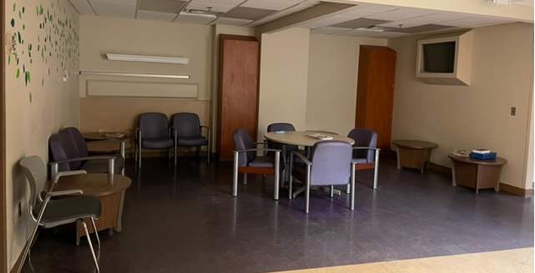

Slide 15
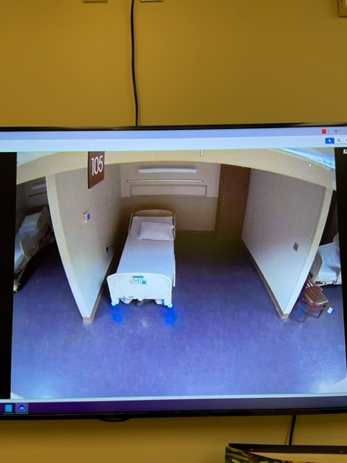
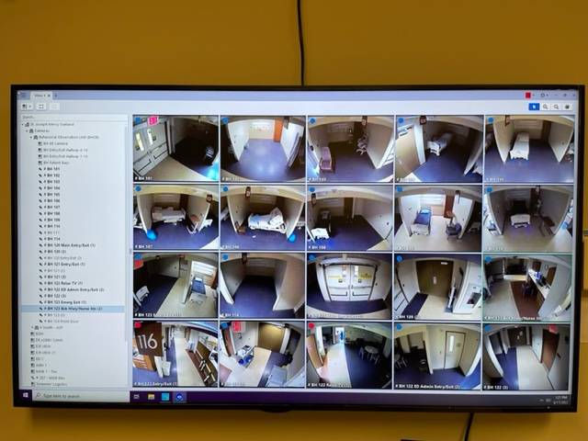

Slide 16
Sustainability
Make changes as needed. Able to design a new space around model utilizing camera observation with new construction plans.
Extrapolation of model previously established by former DNP student for same patient population residing outside inpatient psychiatric unit . Can model be used for other types of psych patients?
Continue collecting feedback and adjusting model as needed

Slide 17
Dissemination
Share data and analysis with stakeholders and staff
Share with senior leadership via Poster Presentation or PowerPoint
Possible conference presentation at ENA or APNA conference

Slide 18


Nursing and Healthcare Implications
Pairing an RN with a mental health technician in a ligature-resistant milieu outside the Main ED, supported by camera observation, may be a safer and more therapeutic environment to render care to suicidal patients at low and moderate risk at less cost.
This practice may result in fewer restraint episodes, security interventions, use of antipsychotics, and worker’s compensation claims.
This approach may allow for a more proactive anticipation of patient needs and subsequent intervention rather than reactive to a crisis.
This project was based on a previous DNP project, helping to bring evidence to practice

Slide 19

Thank you
Family
Mentor: Dr Doug Dascenzo
Inspiration: Dr Renay Gagleard
Stake holders/co -workers: D. Kakar MD, R. Mehta MD, Dr. A Vanderwal, Kaylin Suppon, Devon Dearing-Manning, Jim Beck, Gina Flavin
Chair: Dr Arthur Ko
Reader: Dr. Roseanne Burson

Slide 20
References
(n.d.). The Joint Commission. Retrieved October 2, 2021, from https//:jointcommicciom.org/r3_report_18_national_patient_safety_goal_for_suicide_prevention/
(2021, October 2). NIH. Retrieved October 2, 2021, from www.nimh.nih.gov/healthtopics
(2021, October 2). SAMSHA. Retrieved October 2, 2021, from www.SAMSHA.gov/find-help/disorders
Boudreaux, E. D., Jaques, M. L., Brady, K. M., Matson, A., & Allen, M. H. (2015). The patient safety screener: Validation of a brief suicide risk screener for emergency department settings. Archives of Suicide Research, 19(2), 151–160. https://doi.org/10.1080/13811118.2015.1034604
Butts, J. B. (2017). Philosophies and theories for advanced nursing practice (3rd ed.). Jones & Bartlett Learning.
Duffy, J. R., & Brewer, B. B. (2011). Feasibility of a multi-institution collaborative to improve patient-nurse relationship quality. JONA: The Journal of Nursing Administration, 41(2), 78–83. https://doi.org/10.1097/nna.0b013e3182059463
Haney, K. (2019). Keeping psychiatric patients safe in our nation's emergency departments. The Journal of Legal Nurse Consulting, 30(2), 20–23. https://doi.org/10.30710/jlnc.30.2.2019.20
Instructions: The social determinants of mental health: Definitions, distinctions, and dimensions for professional case management: Part 1. (2021). Professional Case Management, 26(3), E9–E10. https://doi.org/10.1097/ncm.0000000000000507

Slide 21
References
Johnson, J. K., & Sollecito, W. A. (2020). McLaughlin and Kaluzny's Continuous improvemetn in health care (5th ed.). jones & bartlett learning.
Kraft, C. M., Morea, P., Teresi, B., Platts-Mills, T. F., Blazer, N. L., Brice, J. H., & Strain, A. K. (2021). Characteristics, clinical care, and disposition barriers for mental health patients boarding in the emergency department. The American Journal of Emergency Medicine, 46, 550–555. https://doi.org/10.1016/j.ajem.2020.11.021
Kroll, D. S., Stanghellini, E., DesRoches, S. L., Lydon, C., Webster, A., O'Reilly, M., Hurwitz, S., Aylward, P. M., Cartright, J. A., McGrath, E. J., Delaporta, L., Meyer, A. T., Kristan, M. S., Falaro, L. J., Murphy, C., Karno, J., Pallin, D. J., Schaffer, A., Shah, S. B.,...Mulloy, D. F. (2020). Virtual monitoring of suicide risk in the general hospital and emergency department. General Hospital Psychiatry, 63, 33–38. https://doi.org/10.1016/j.genhosppsych.2019.01.002
Mills, P. D., Soncrant, C., & Gunnar, W. (2020). Retrospective analysis of reported suicide deaths and attempts on veterans health administration campuses and inpatient units. BMJ Quality & Safety, 30(7), 567–576. https://doi.org/10.1136/bmjqs-2020-011312
Mills, P. D., Watts, B., DeRosier, J. M., Tomolo, A. M., & Bagian, J. P. (2011). Suicide attempts and completions in the emergency department in veterans affairs hospitals. Emergency Medicine Journal, 29(5), 399–403. https://doi.org/10.1136/emj.2010.105239
Nazem, S., Matarazzo, B., & Wortzel, H. (2019). Suicide risk assessment and management :tips for improving Care and outcomes. Psychiatric Times.
Newscap: Joint commission revises national patient safety goal for suicide prevention. (2019). AJN, American Journal of Nursing, 119(3), 13. https://doi.org/10.1097/01.naj.0000554020.75227.67

Slide 22
References
Nordstrom, K., Berlin, J., Nash, S., Shah, S., Schmelzer, N., & Worley, L. (2019). Boarding of mentally ill patients in emergency departments: American psychiatric association resource document. Western Journal of Emergency Medicine, Volume 20, Issue 5, 20(5), 690–695. https://doi.org/10.5811/westjem.2019.6.42422
Petrik, M. L., Gutierrez, P. M., Berlin, J. S., & Saunders, S. M. (2015). Barriers and facilitators of suicide risk assessment in emergency departments: A qualitative study of provider perspectives. General Hospital Psychiatry, 37(6), 581–586. https://doi.org/10.1016/j.genhosppsych.2015.06.018
Richmond, J. S., Dragatsi, D., Stiebel, V., Rozel, J., & Rasimas, J. J. (2021). American association for emergency psychiatry recommendations to address psychiatric staff shortages in emergency settings. Psychiatric Services, 72(4), 437–443. https://doi.org/10.1176/appi.ps.201900501
Roaten, K., Khan, F., Brown, K., & North, C. S. (2016). Development and testing of procedures for violence screening and suicide risk stratification on a psychiatric emergency service. The American Journal of Emergency Medicine, 34(3), 499–504. https://doi.org/10.1016/j.ajem.2015.12.014
Sikka, R., Morath, J. M., & Leape, L. (2015). The quadruple aim: Care, health, cost and meaning in work. BMJ Quality & Safety, 24(10), 608–610. https://doi.org/10.1136/bmjqs-2015-004160
Smith, M. C. (2015). Nursing theories and nursing practice (4th ed.). F. A. Davis Company.
Special Report: Suicide Prevention in Health Care Settings. (2017, November). The Joint Commission. Retrieved October 4, 2021, from www.jointcommission.org/resources/suicide

Slide 23
References
Utley, R., Henry DNP NE-BC, Kristina, & Lucretia, S. C. (2017). Frameworks for advanced nursing practice and research: Philosophies, theories, models, and taxonomies (1st ed.). Springer Publishing Company.
Williams, S. C., Schmaltz, S. P., Castro, G. M., & Baker, D. W. (2018). Incidence and method of suicide in hospitals in the united states. The Joint Commission Journal on Quality and Patient Safety, 44(11), 643–650. https://doi.org/10.1016/j.jcjq.2018.08.002

